Slide 1
Fashion System Smart outfit suggestions
Smart outfit suggestions

Slide 2
Introduction
This project uses advanced image processing to analyze user photos or live camera input. It detects face and skin tone to recommend personalized formal and classic wear outfits that enhance the individuals appearance.

Slide 3
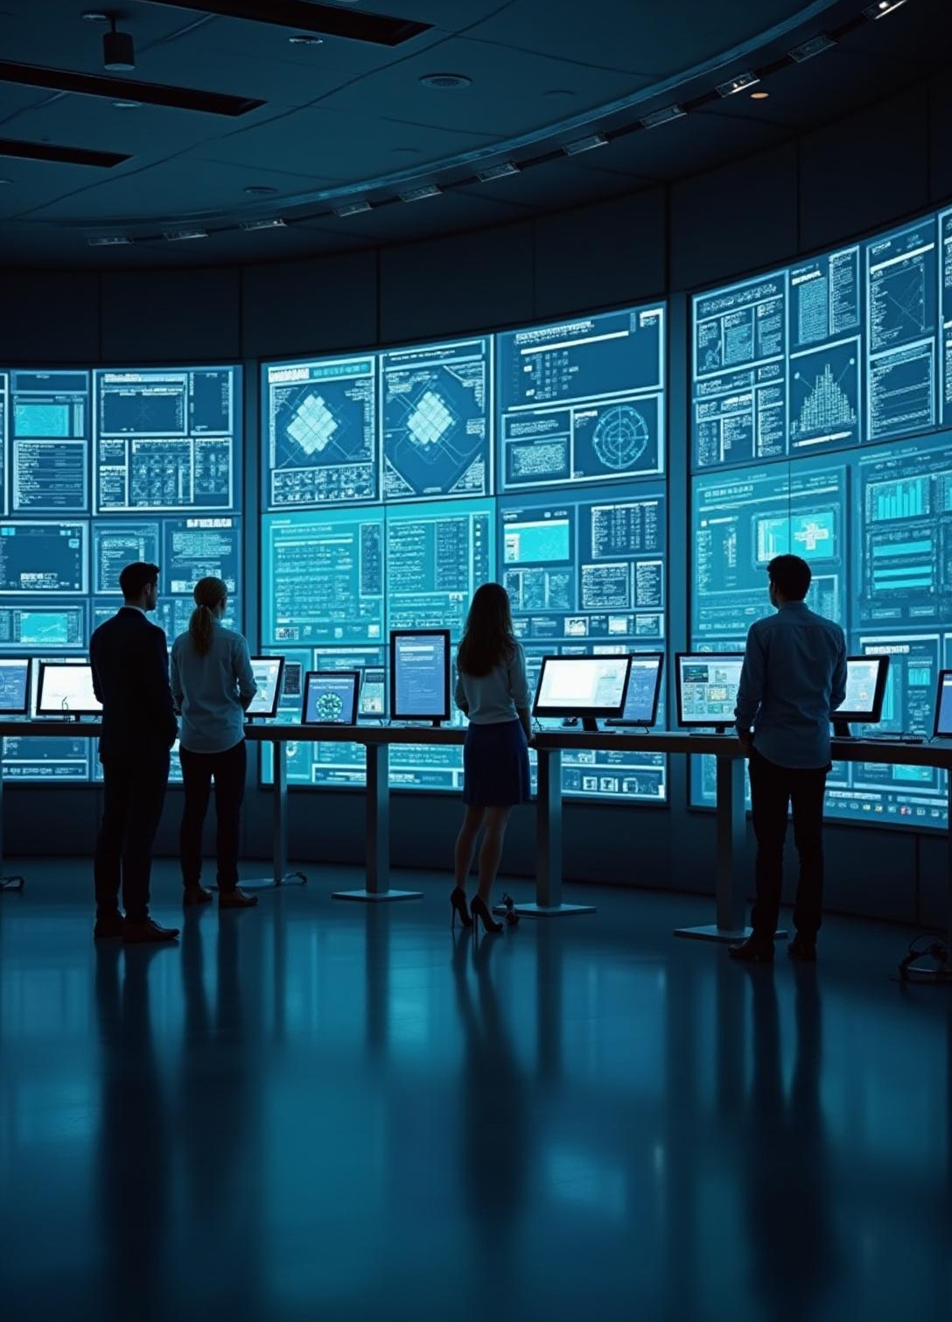
System Overview

Slide 4
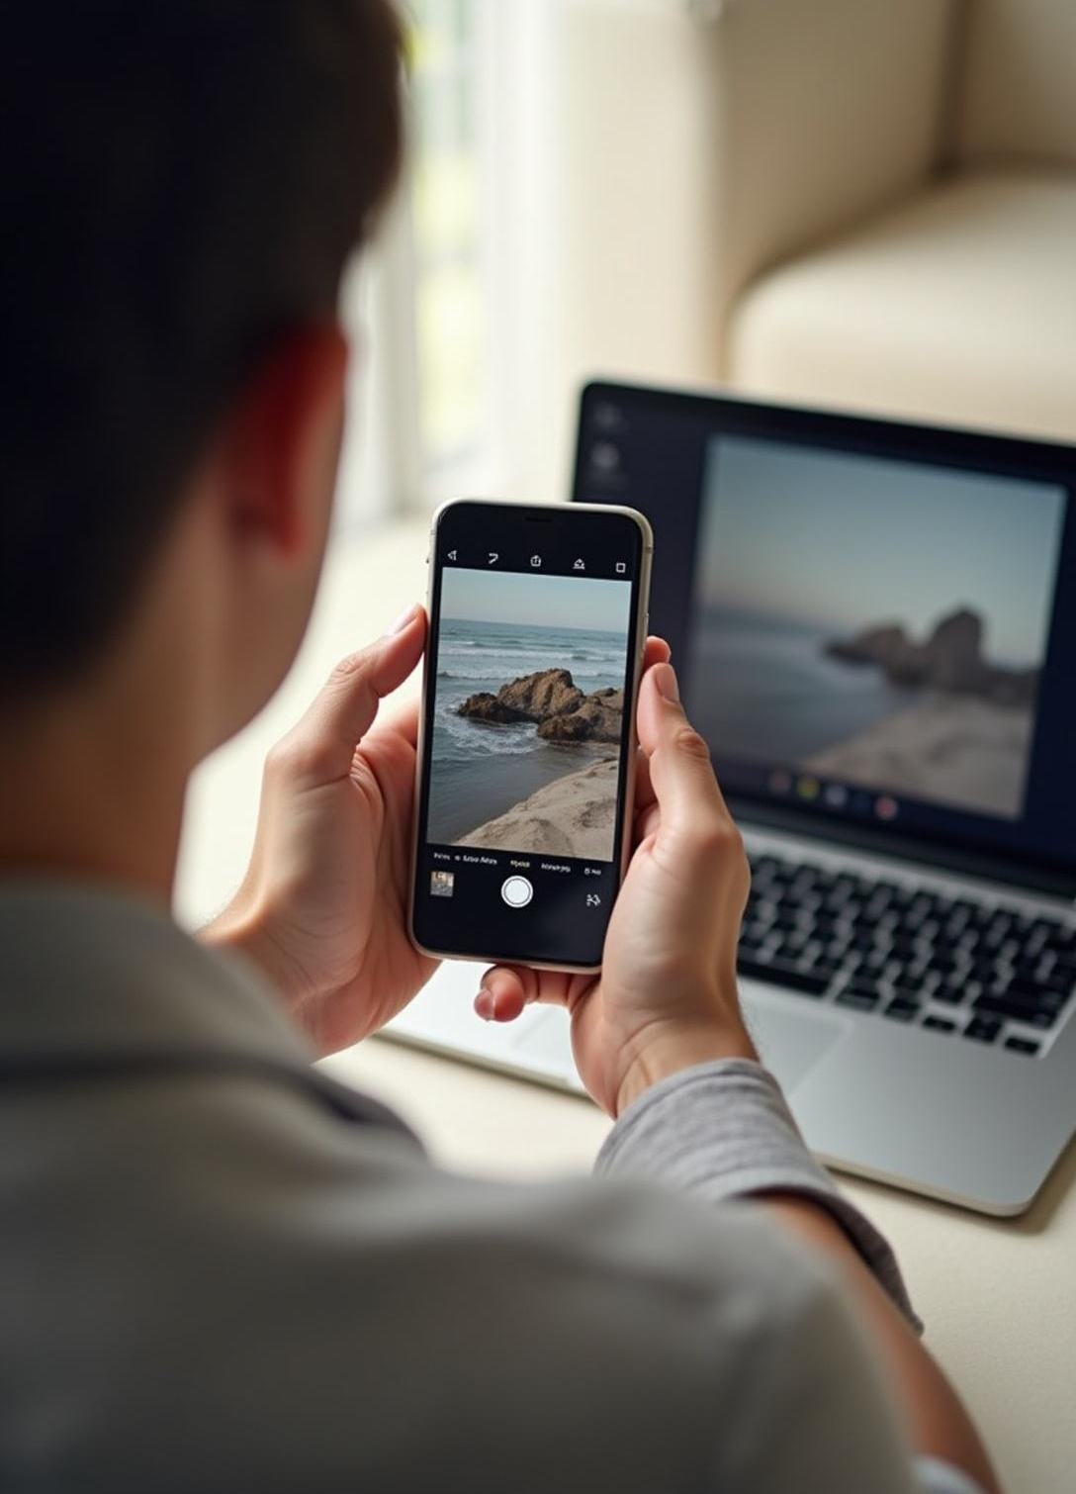
User Input Methods (Upload & Camera)
Users can upload pictures or use their device camera for real-time image capture, enabling flexible and convenient input for analysis.

Slide 5
Face & Skin Tone Detection
The system applies facial recognition and skin tone analysis algorithms to accurately identify relevant features for tailored fashion recommendations.

Slide 6
Recommendation Algorithm
The algorithm uses machine learning to analyze skin tone and facial features, matching users with the most flattering formal and classic outfit options. It continuously improves recommendations with user feedback.

Slide 7
Formal Wear Suggestions
Our system recommends formal wear that complements skin tone, including tailored suits, shirts, and accessories for a refined, professional appearance.

Slide 8
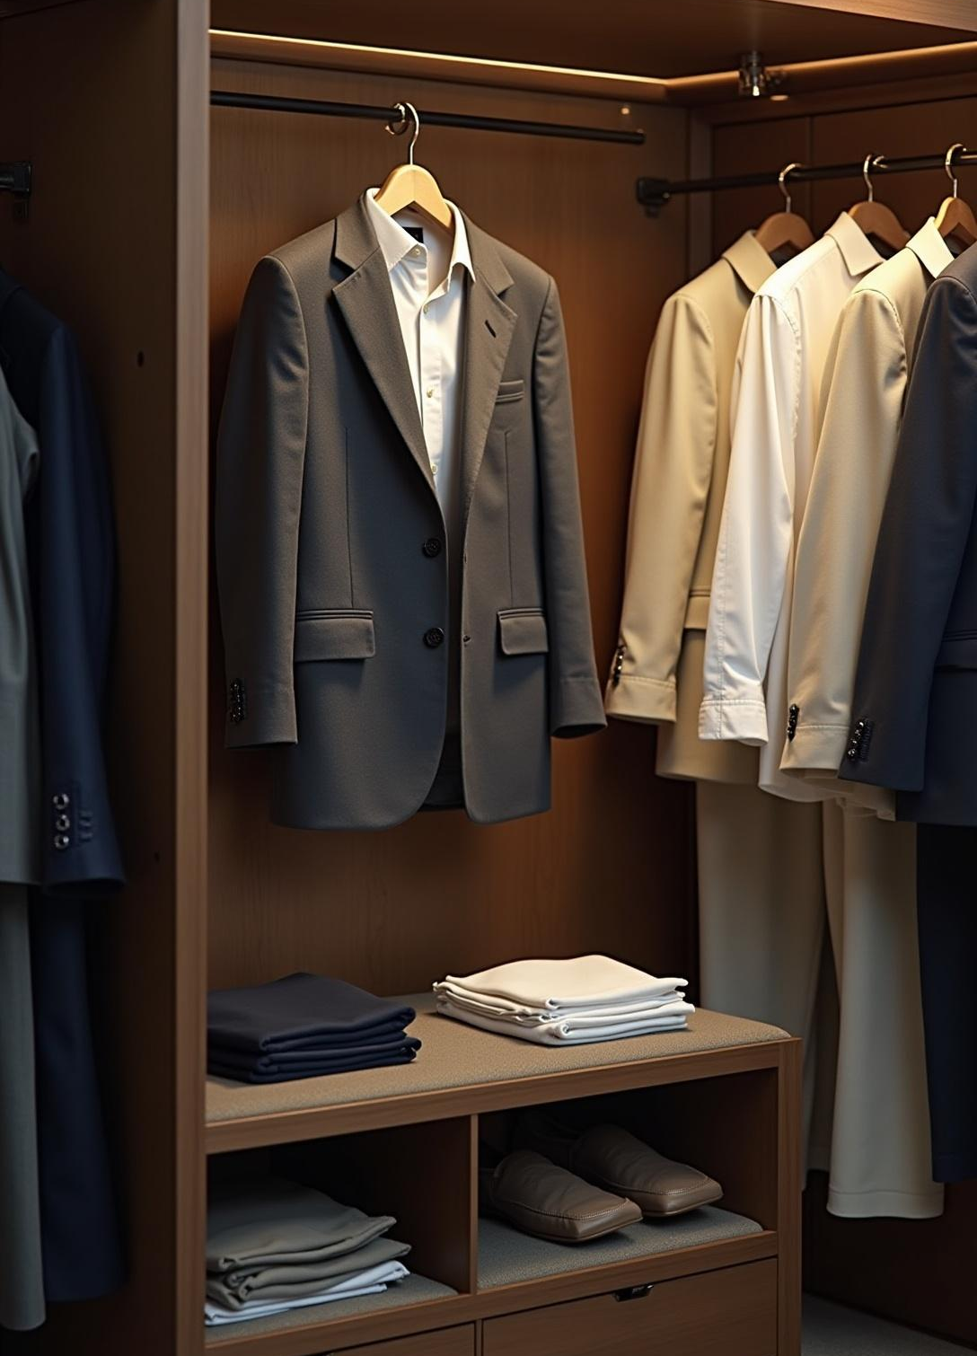
Classic Style Outfits
Classic outfit suggestions focus on timeless styles and cuts, emphasizing fabrics and colors that enhance individual skin tones for enduring elegance.

Slide 9
Personalization by Skin Tone
Outfit colors and styles are customized based on precise skin tone detection, ensuring recommendations harmonize with individual complexion for maximum impact.

Slide 10
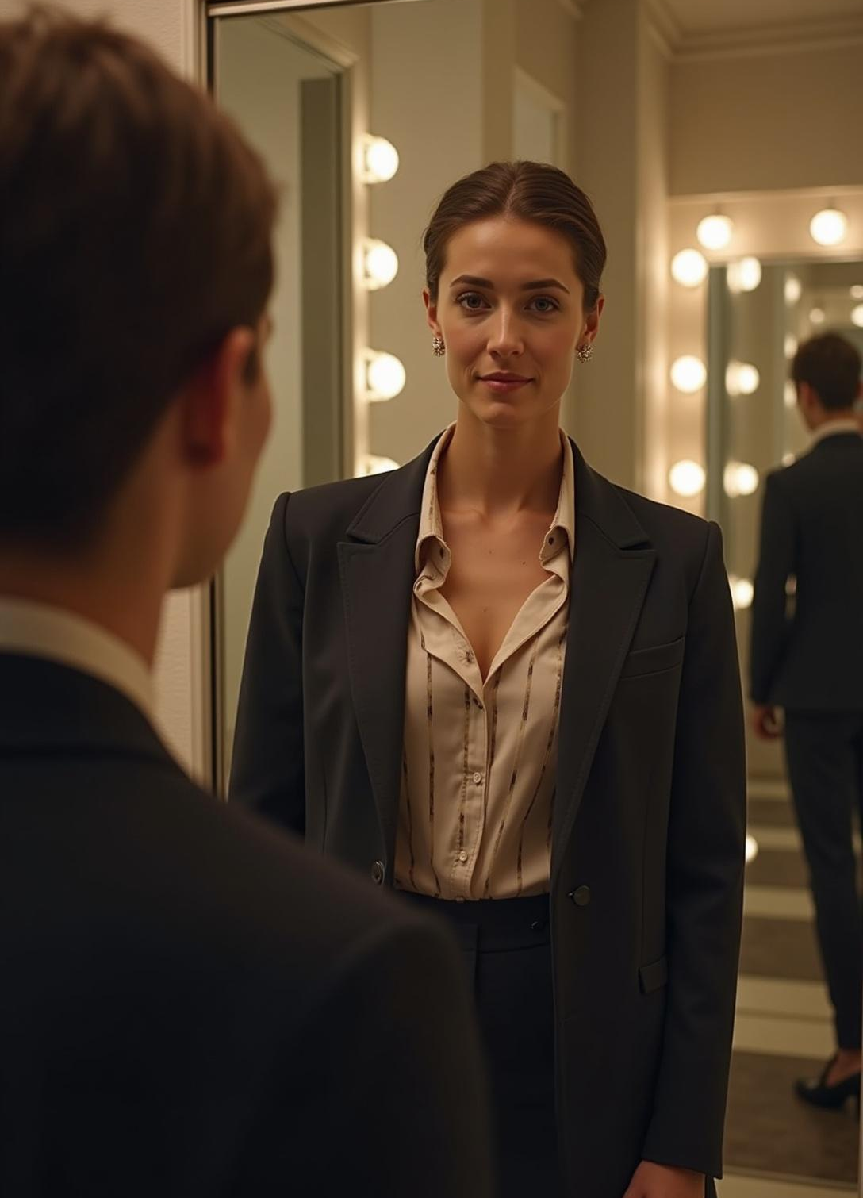
Conclusions
This fashion recommendation system offers personalized, data-driven style advice by combining advanced image analysis with fashion expertise, enhancing user confidence and style in formal and classic wear.

Slide 11
Thank you!
Do you have any questions?
+00 000 000 000

